Slide 1
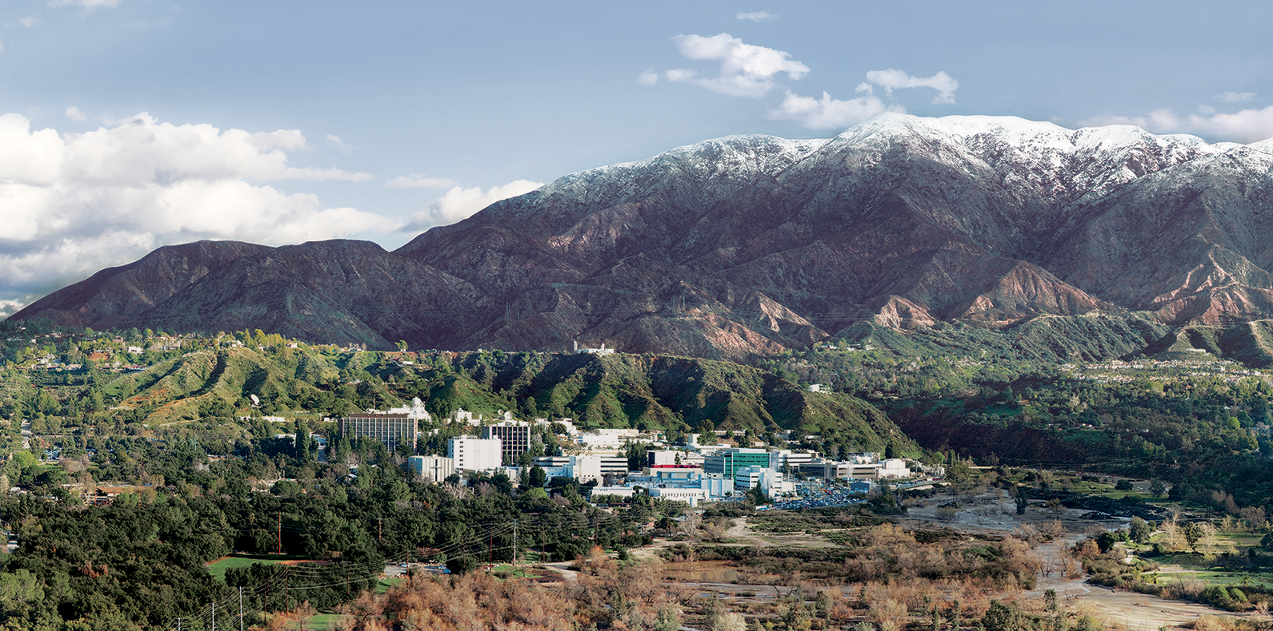
6. Matched filters for spectral signature detection
Dr. David R. Thompson
Jet Propulsion Laboratory, Imaging Spectroscopy Group
July 20, 2019

Slide 2
Goals for this module
Apply the Beer-Lambert law
Use adaptive spectral matched filters to detect subtle signals in radiance data
Use matched filters on reflectance data

Slide 3
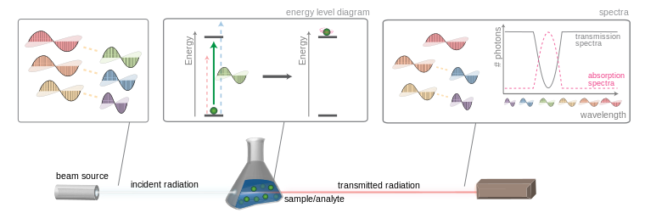
Absorption by a medium: Beer-Lambert law
Wikimedia

Slide 4
Absorption by a medium: Beer-Lambert law
Wikimedia
R_{out}(λ) = R_{in}(λ) e^{-κℓ}
Path length
Absorption coefficient (m⁻¹)

Slide 5

Trace gas measurement
Mixing ratio length in ppm m
Transmission α e^{- κ c x}
Mixing ratio
c
Absorption coefficient
x
Optical path length

Slide 6
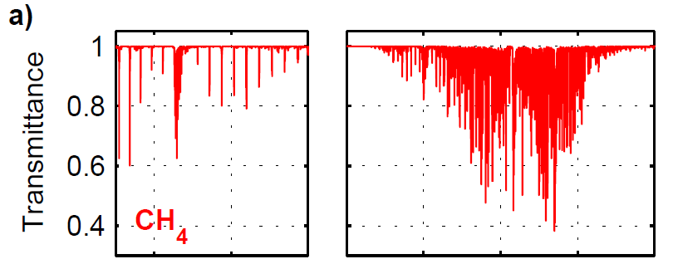
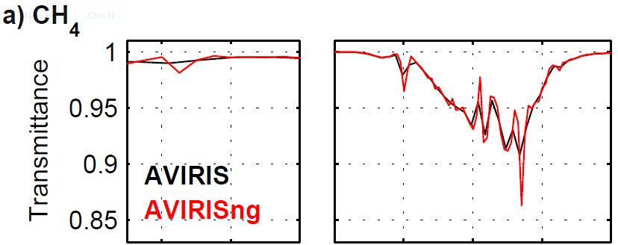
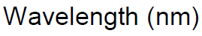
CH₄ absorption signatures

Slide 7
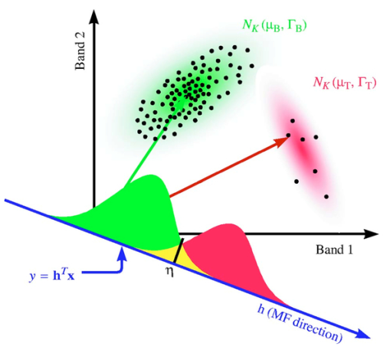
Matched filter intuition
Image from [Dimitris G. Manolakis, Optical Engineering, 44(11), 116401 (2005). https://doi.org/10.1117/1.2125487]

Slide 8
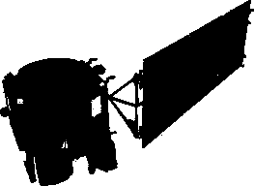
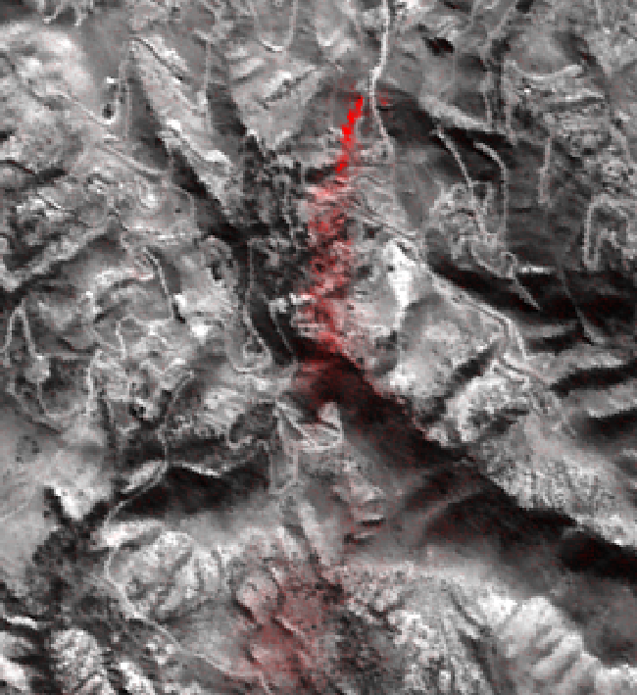
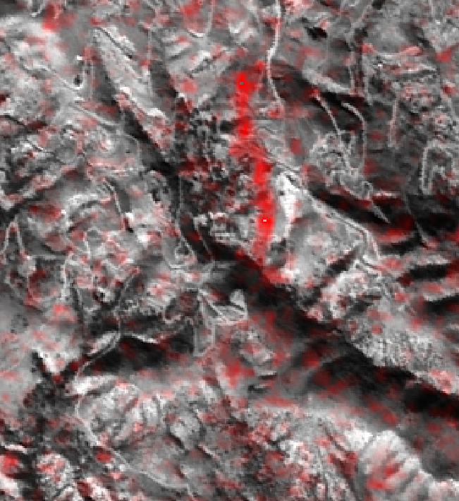
Aliso canyon gas storage leak
ER-2 at 6.6 km altitude, 1/12/2016
EO-1 Spacecraft at LEO, 1/1/2016
500 m
N
Thompson et al., Geophys. Res. Lett. (2016)

Slide 9
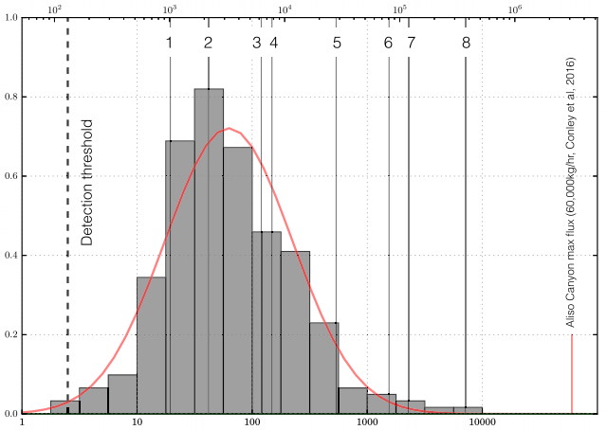
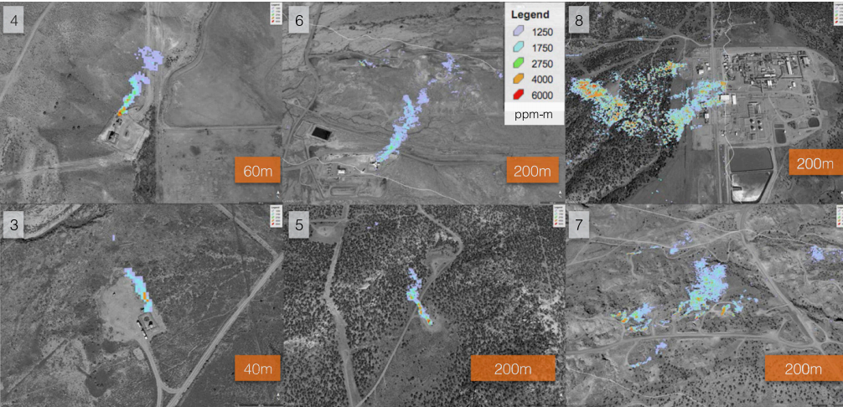
Fugitive CH₄ emissions at Four Corners, NM
Frankenberg, Thorpe, Thompson et al., PNAS 2016

Slide 10
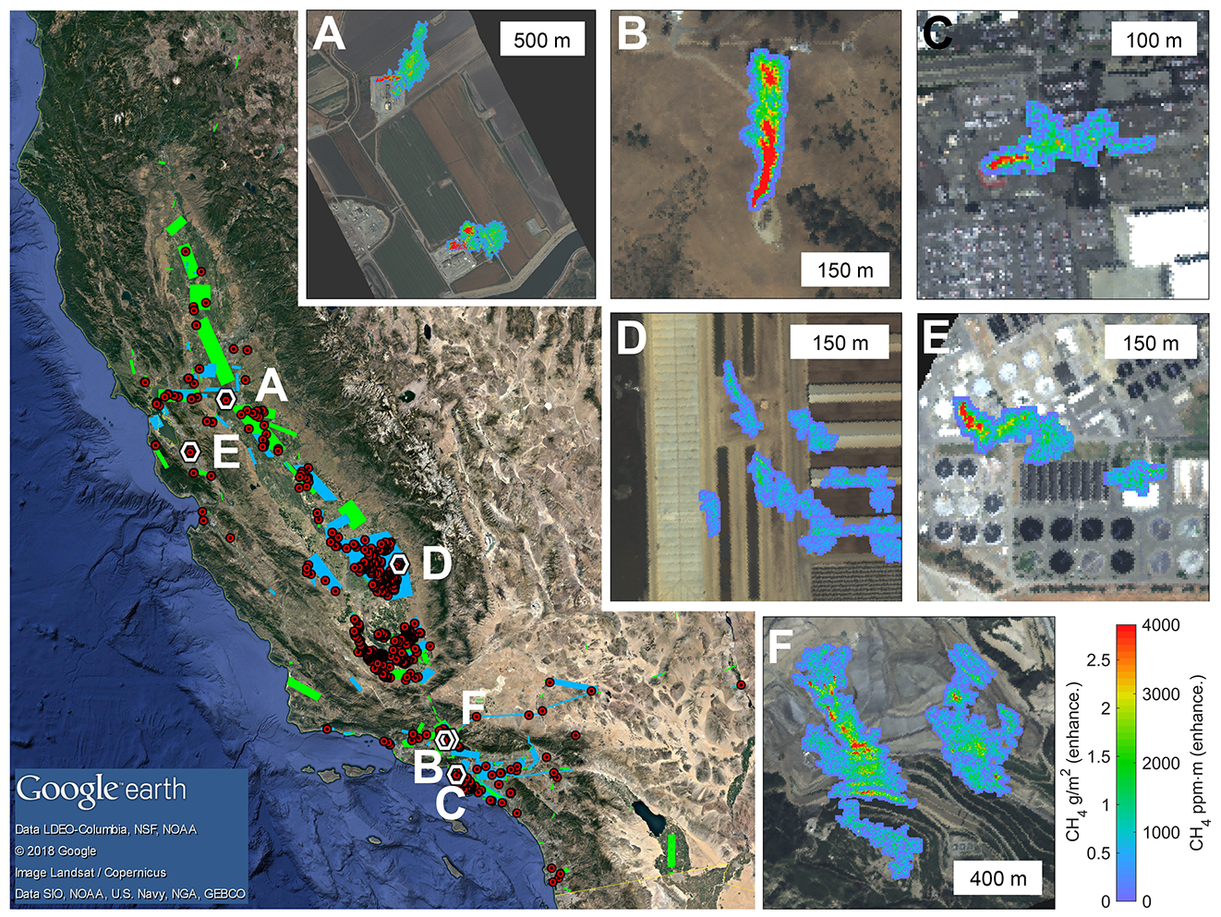
CH₄ in California
Duren et al. (in review), Thorpe et al. (2016), Thompson et al. (2015)

Slide 11
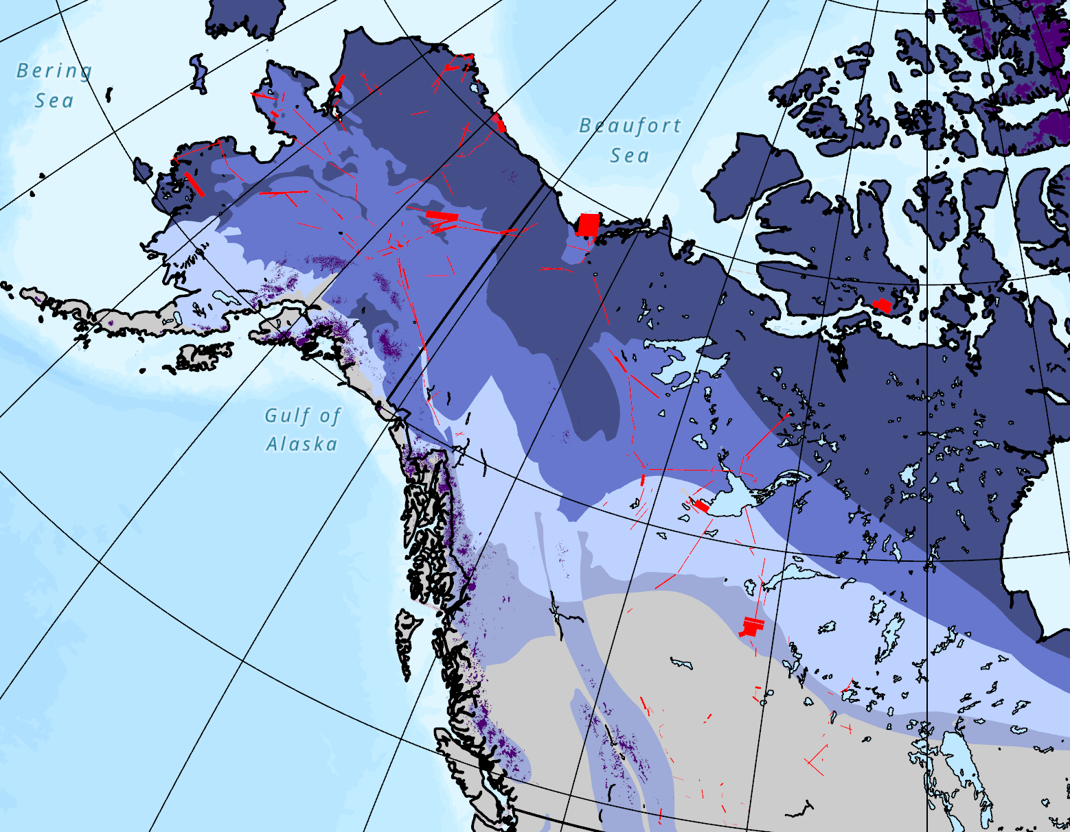
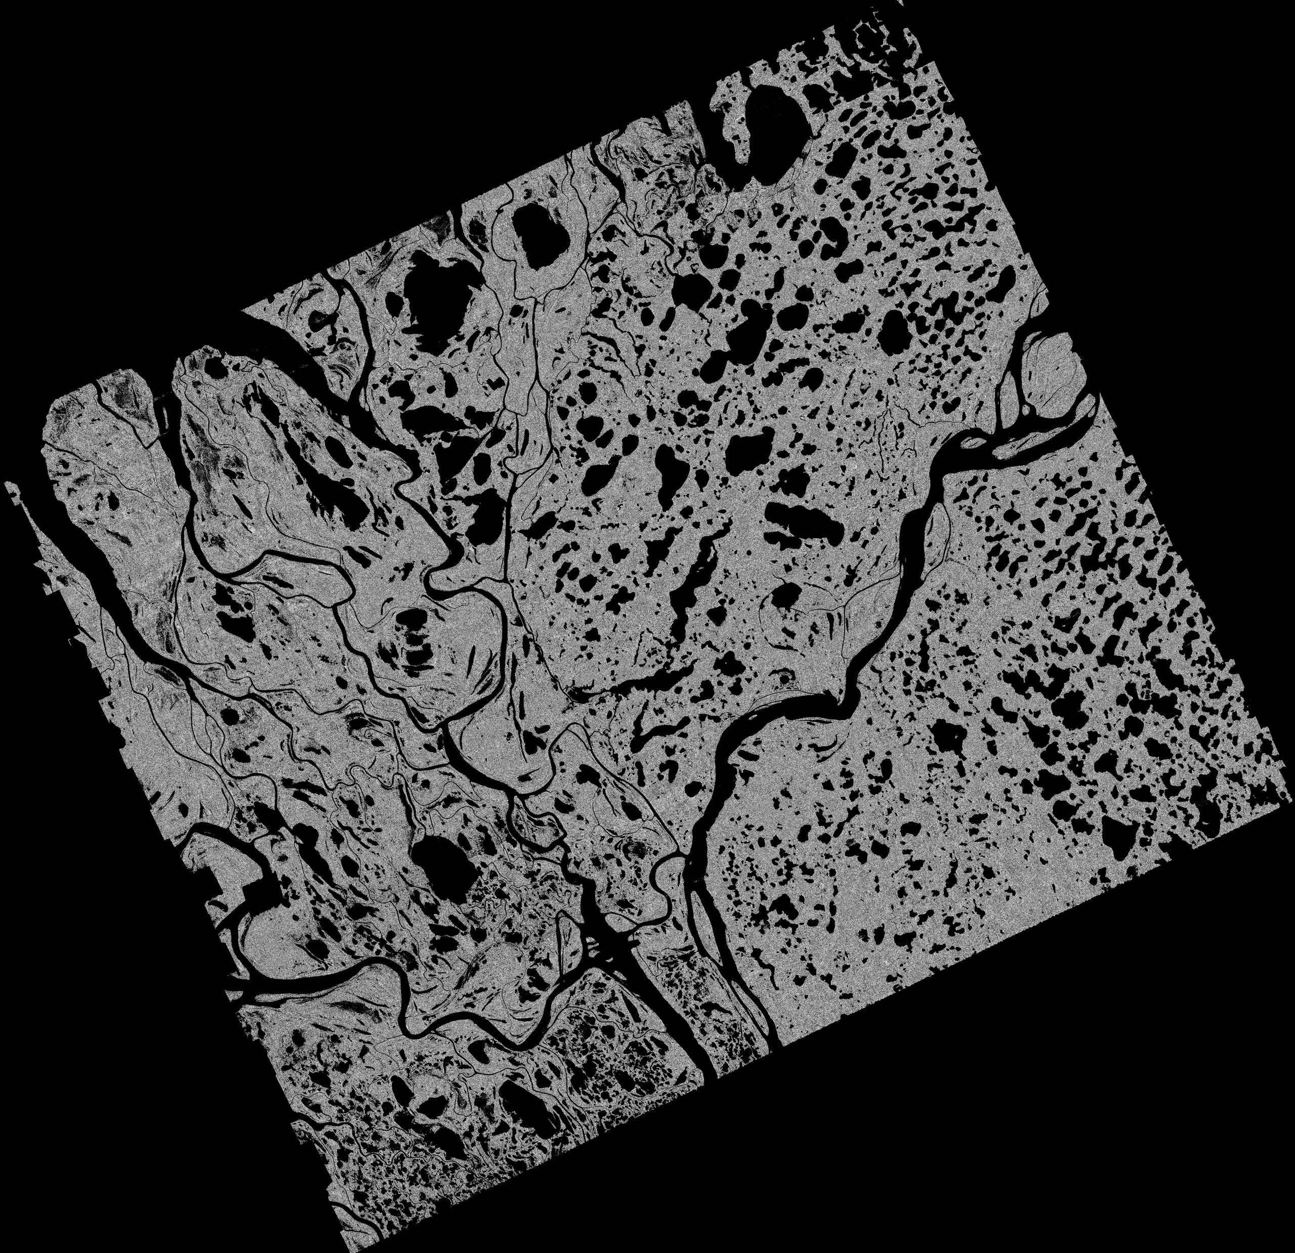
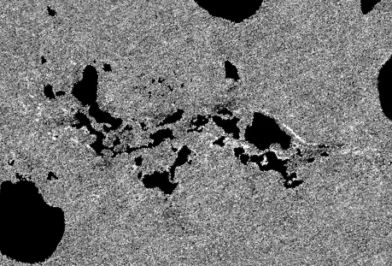
Arctic CH₄ Emissions Elder, Thompson, et al. (in preparation) Analysis of AVIRIS-NG data from the ABoVE campaign, PI: Chip Miller
145° W
60° N
10 km
1 km

Slide 12
Arctic-wide statistics reveal a two component power law
Site-level, lake littoral control?
y = 0.021x^{-0.65} R² = 0.97
Poisson rate of CH₄ hotspots
Landscape, proximal wetlands/ water table control?
y = 0.004x^{-0.16} R² = 0.99
Elder, Thompson,
et al. (in preparation) Analysis of AVIRIS-NG data from the ABoVE campaign
PI: Chip Miller
Distance to standing water (m)

Slide 13
Detection via matched filter
Matched filter applied independently in each column

Slide 14
Detection via matched filter
Matched filter applied independently in each column
Mixing ratio length
Tested spectrum
Background mean
Background covariance
target

Slide 15
Detection via matched filter
Matched filter applied independently in each column
Mixing ratio length
Tested spectrum
Background mean
Background covariance
target
Using the target signature

Slide 16
Detection via matched filter
Matched filter applied independently in each column
Mixing ratio length
Tested spectrum
Background mean
Background covariance
target
Using the target signature
Unit absorption coefficient

Slide 17
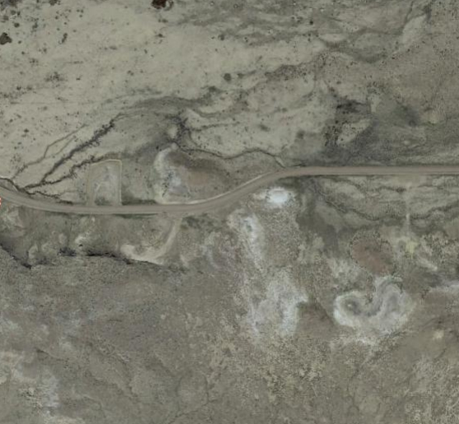
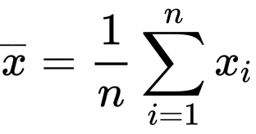
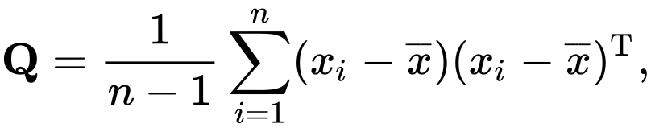
Estimating the background radiance distribution
1. Extract spectra from a representative area (full scene, square, column, or cluster?)
or
or
or…
2. Use the sample mean, sample covariance!

Slide 19
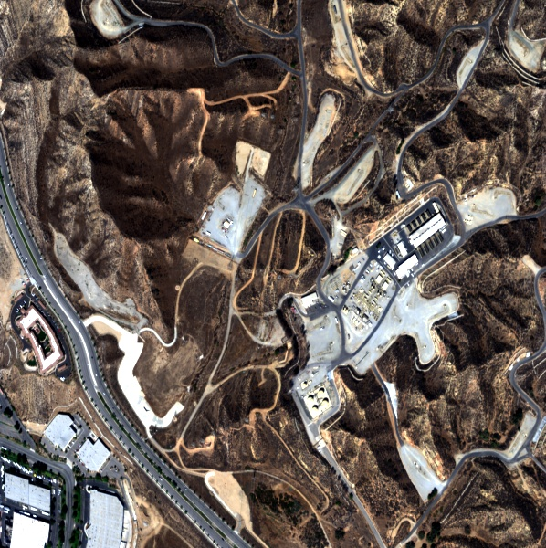
Exercise 6: CH₄ signature detection
Objective: Identify, and determine the source of, a fugitive CH₄ emission from a petrochemical facility.
The image at left is a non-orthorectified image from an AVIRIS-NG flight in 2016. Apply a background-whitened matched filter using the target signature of methane absorption (the file named ang_ch4_unit_3col_425chan.txt).
Find the CH₄ enhancement. What is the source location, and what is the maximum enhancement in ppm m?
Extra credit: try some different strategies for estimating the background covariance and non-enhanced radiance

